Slide 1
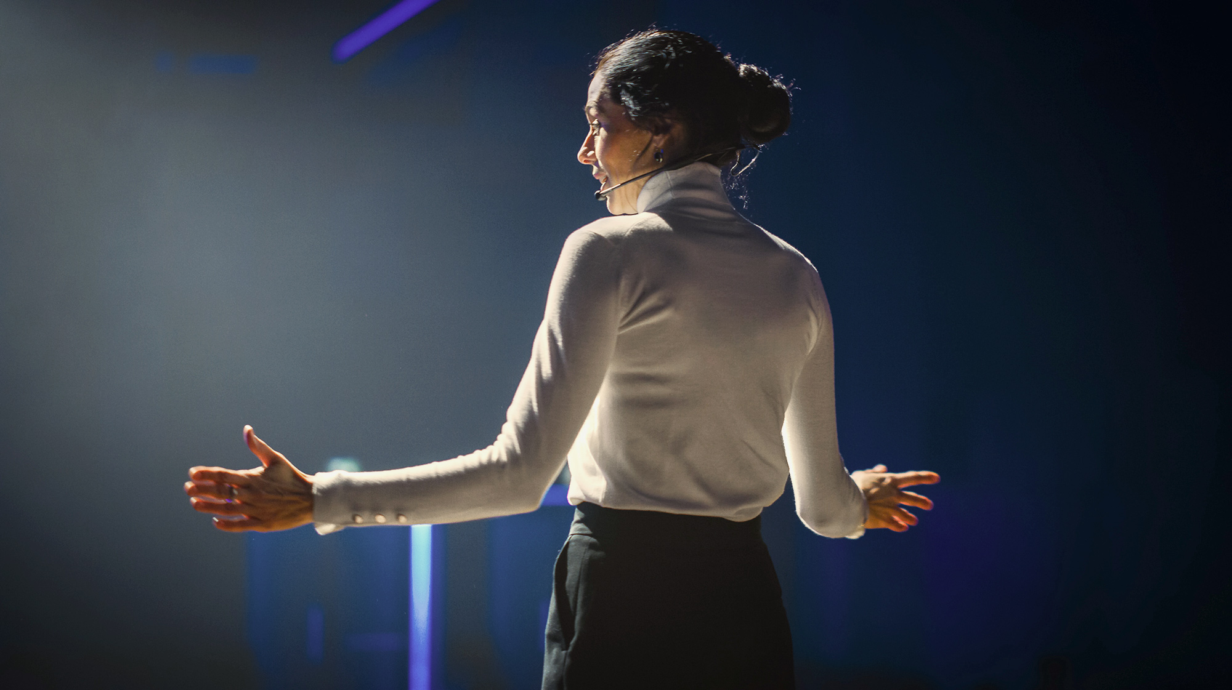
Public Speaking Assistive Interface Market Survey

Slide 2
What are the most common forms these systems take?
The vast majority of public speaking assistive interface systems that I found came in the form of a mobile app or a web app.
On the academic side there were a variety of different systems (most of which are outside of the scope of our project).

Slide 3
I do feel that looking at which systems are the most popular is a hugely beneficial indicator for identifying the best systems out there and what consumers value/ are looking for in a system of this type. So…

Slide 4
What do the most of the successful public speaking apps and webapps all have in common?
They all have good functionality, run smoothly and have a very clean, user friendly GUI.
Nearly all of them include some form of ‘progress tracker’, whether that is of the form of ‘daily warm ups’, ‘number of recordings’, ‘completed activities’ etc. I believe this is quite key for users as if they can see tangible progress, it may reinforce to them the effectiveness of the app and thus they will continue to use it.
Almost all are all free to download and include a paid ‘premium subscription plan’ to access a greater number of features/ materials within the app. If an individual user who is looking to download a speaking assistive app they will most likely try a free one over one that requires an upfront fee, I believe that is a big reason as to why this business model proves more effective than others.

Slide 5
What do the most of the successful public speaking apps and webapps all have in common? (Continued)
Having lessons/courses included as a feature in public speaking feedback assistive applications seems to be quite a common occurrence. It may be because these two features when used in conjunction with one another can be more effective than simply just providing feedback. Given the popularity of the ‘TED Masterclass’ app which is purely lesson based and provides no feedback indicates to me that it is a feature that consumers really value.
Of the most popular systems that provide automated feedback on the market (not including academic projects such as ROC Speak, Cicero, e.t.c), the majority of them only provide feedback based on audio behaviour. This may leave a gap in the market for an automated public speaking feedback system that gives feedback based on visual behaviour via a camera.

Slide 6
What are the most common forms of monetization?
(Especially for systems that are in the form of an app), monetization is by far most commonly found in the form of a ‘premium subscription format’, where users pay monthly for access to extra features, materials e.t.c that are not available in the free/standard version of the system.
The paid systems with a monthly fee ranged anywhere from $10 a month to $50 dollars a month for personal use, with the majority of these paid systems sitting at the upper end of this range.
There was also a handful of paid apps that required a one-off initial fee to access all of the functionality of the system, this was in the range of $3 - $15.

Slide 7
What key indicators do automated feedback systems commonly look for?
Indicators in which feedback is given on most commonly includes:
  Volume of speech/energy
  Speaking pace (most commonly words per minute)
  Number and length of pauses
  Number of ‘filler words’ (um, like, etc. )
  Clarity of speech
  Pitch modulation.
Uniquely, The ‘Samsung BeFearless’ system analyses the users heart rate. I think this is quite an interesting idea. Perhaps, if it would make sense, our system could integrate with a smart watch device?

Slide 8
Case Study
Orai
Voice Vibes
RocSpeak

Slide 9
Orai for Public Speaking (Mobile App and Web App):
KEY FEATURES:
• Instant speech feedback using AI: (Filler words (um, you know, basically), How fast you speak, Your energy level, Vocal clarity).
• Provides Micro-lessons on public speaking
• Provides a transcript of what you say
• Save your previous recordings
• Ability to share your recording and transcript with friends/colleagues
• Freestyle mode to practice anytime, anywhere
• Script mode to practice a prepared speech; simply copy/paste it into the app and tap record

Slide 10
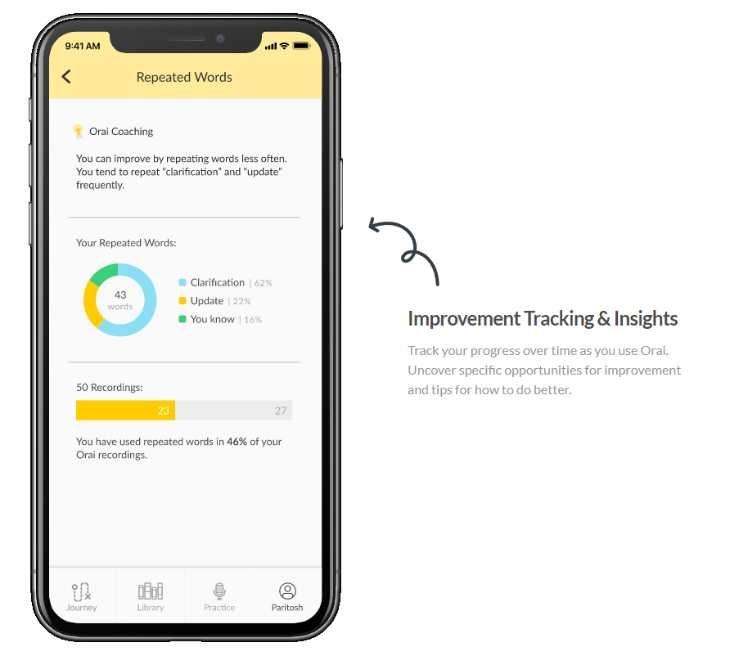
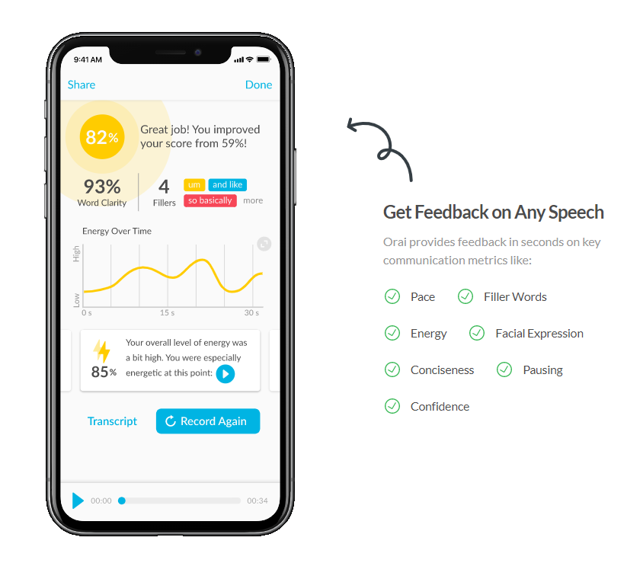
Example of the apps delayed feedback:

Slide 11
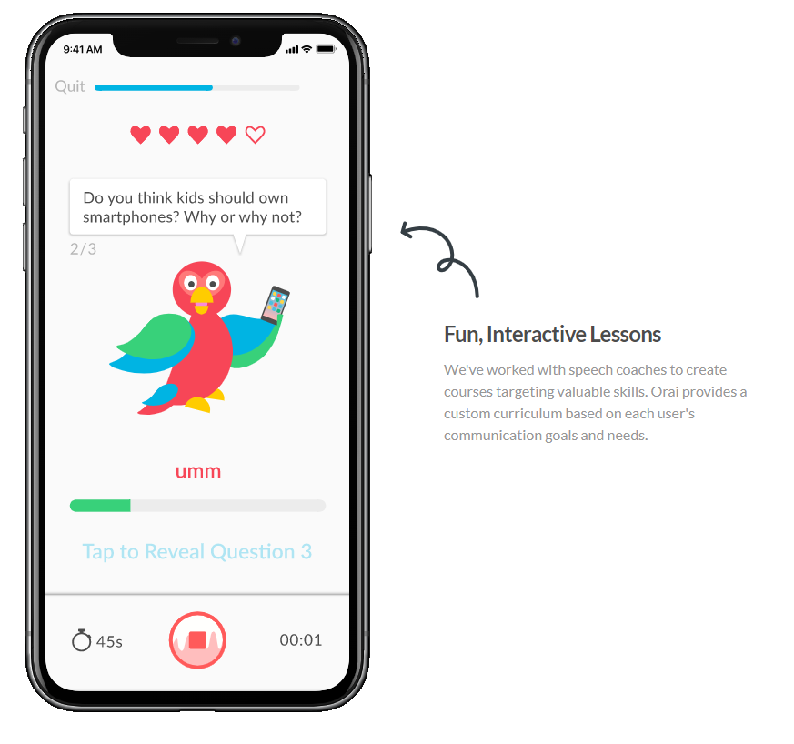
Example of the apps interactive lesson feature:

Slide 12
Example of the progress tracking within the app

Slide 13
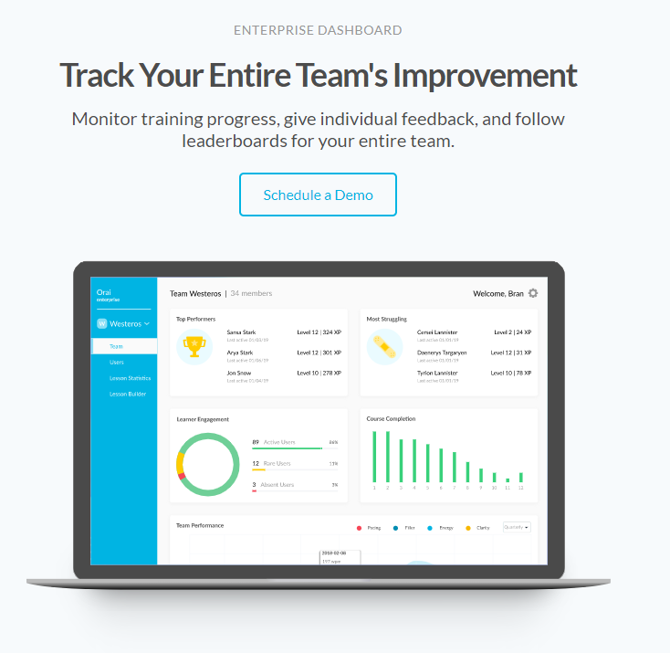
Example of the enterprise features included within the app:

Slide 14
Key Take-aways from Orai:
This was the first suggestion on the IOS store when I typed in “Public Speaking”. It also has a very high 4 and a half star rating with 250 reviews - very popular with users. This looks to be one of the most popular public speaking assistive interfaces apps on the IOS market place – perhaps this gives us a good indication of what consumers might be looking for.
Not clear if processing is done on-device or on the cloud but my guess would be that it is a combination of the two.
The app has a very clean and useable interface.
Provides both real time feedback and delayed results.
It doesn’t just provide feedback, it also provides lessons for a variety of different scenarios.
Allows the user to share their feedback with friends and colleagues.

Slide 15
Other Notes/Thoughts:
The progress tracking featured in the app is an interesting idea, perhaps something we should think about, if users can see tangible progress it may make them more likely to continue using the app and reinforce to the user the effectiveness of the app.
Having lessons/courses included as features in public speaking assistive applications seems to be quite a common occurrence. It may be because these two features when used in conjunction with one another can be more effective than simply just providing feedback.

Slide 16
Voice Vibes
Description (Taken from the zoom app market place): “AI-powered coaching tool analyzes your recordings to show exactly how you sound, and where you can improve, so you can make the best impression every time. “
How does it work: “Record or upload any speech or practice session, or easily select and analyze segments of your zoom recordings (from 15 seconds to 15 minutes) to receive personalized, automated feedback in minutes. AI algorithms trained on millions of human perception ratings provide helpful feedback on your oral delivery while human collaboration features enable additional feedback through coach and team sharing, scorecards and reporting.”
Automated feedback based on: Pace, pausing, Strength of Opening, Clarity, Upspeak, Um/Uh filler counter, programmable word and phrase detection, Confidence, Boring, Authentic, Captivating, Pushy, Timid and more.

Slide 17
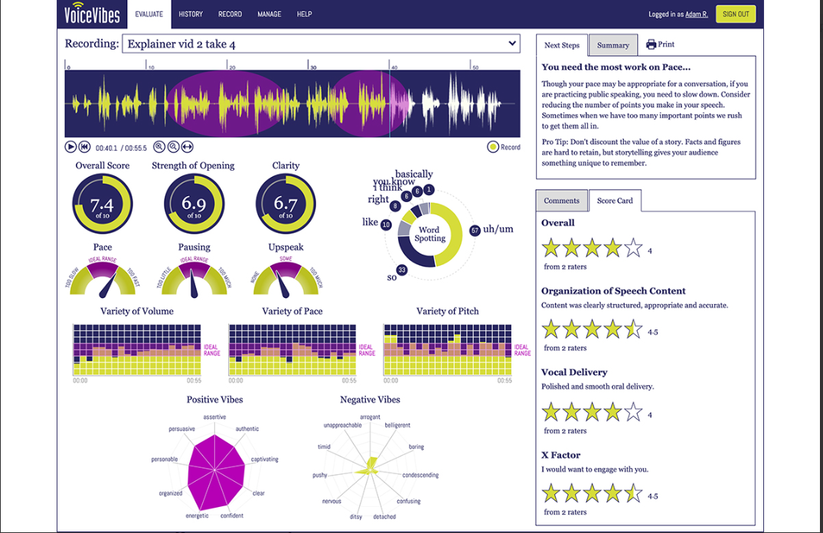
Screen shot of the extension:

Slide 18
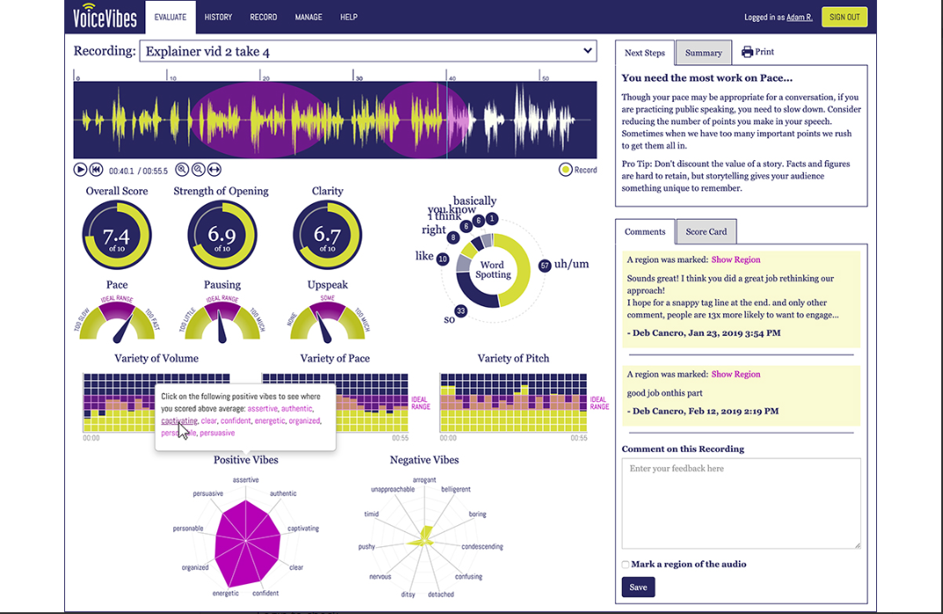
It also allows other users to comment:

Slide 19
Key Take-aways from VoiceVibes
Integration with zoom as a downloadable extension.
Zoom calls can be imported to be analysed OR Audio or Video files, or publicly available URLs
Does not provide feedback in real time, it provides only delayed feedback.
Provides feedback only on audio behaviour.
Processing appears to be done on the cloud (Although I am not certain).
Assignments can be set for other users. (For example Receive an overall rating of ‘X’)
States it can track and analyse multiple speakers.

Slide 20
RocSpeak
I won’t go into too much detail as I believe you are already familiar with this system.
If we are discussing analysing visual behaviour using a camera, this appears to be the only system that does it using a web cam/phone cam and thus it is definitely a system we should look at in more detail.

Slide 21
Key Take-aways from RocSpeak
Provides very detailed automated feedback based on both visual and audio behaviour – this is the only system I have seen that is able to do this with just a camera.
Can only analyse one person speaking at a time.
Provides only delayed feedback after a presentation is finished, no real-time feedback.
It’s a web application where processing appears to be done on the cloud.

Slide 22
Other Notes/Thoughts:
It has quite a basic GUI and as far as I can tell was created purely for research purposes. – it might be popular in the market if repackaged as a mobile app or zoom extension. Is there any way in working in collaboration with Rochester HCI to build upon their system, improve the GUI and develop it into an app for the IOS marketplace or even an extension for zoom?

Slide 23
For systems that analyse visual behaviour using a form of camera do they look at full body or just the face?
Of the systems that analyse visual behaviour I have come across a variety of different ways of doing it. For example, RocSpeak uses a camera to record the upper half of the users body, predominately looking at the face, whereas Logue makes use of a Kinect sensor and google glasses to record the users full body to provide real-time feedback.

Slide 24
Systems I have explored that are able to analyse an interaction between two people speaking
The ‘analysing and providing feedback for two speakers at once’ feature does not seem to be common at all. VoiceVibes is the only one I have found that claims is able to track, analyse and provide feedback on two speakers at once.

Slide 25
Closing thoughts
As far as I can tell, there appears to be a gap in the market for a user friendly mobile app or zoom extension that is able to provide feedback based on both visual and audio behaviour using just a phone camera or a web cam.

